Slide 1
Operator Environment Forecasts & Trends
Thank you to our sponsor:

Slide 2
Operator Sales Recent History
It now appears foodservice sales peaked in 2015, as employment surged and gasoline prices plummeted.
Nominal sales growth hit about 5%, with real growth of more than 2%.
But the commercial market slowed beginning in the first quarter 2016.
NPD reports traffic has been flat for four consecutive quarters
Same-store sales and traffic for big chains have been particularly soft.
Noncommercial markets continue to show relative strength.
Operators’ two major cost inputs, food and labor, are on the rise.
NRA forecasts 2017 nominal growth of 4.3% with real growth of 1.7%.
Technomic lowered its 2017 forecast to 3.7% and 1.4% in May. It forecasts nominal growth of 3.8% and real growth of 1.4% for 2018.

Slide 3
Technomic Operator Sales Changes & Forecast

Slide 4
Technomic Operator Sales Changes

Slide 5
NRA Operator Sales Changes 2013-2017

Slide 6
NPD Per Capita Visits: 1984-2016
Promise & Challenge
Annual Commercial Foodservice Meals Per Person In the USA
Source: The NPD Group/Annual Eating Patterns of America

Slide 7
Canadian Commercial Foodservice Sales

Slide 8
Recent Sales & Traffic Trends
After strong 2015, data from Technomic, NPD, NRA and others have shown a consistent decline in sales and in some cases traffic.
Until recently, big chain traffic has been consistently negative. Even QSR, where all the traffic growth has been post-recession, has been flat.
Full service continues to be particularly affected.
Fast-casual numbers have been hurt by Chipotle’s dramatic problems.
Even fine dining, positive for years, has seen visits go negative, says NPD.
But easier comparisons seem to be flattening the downward curve.
McDonald’s had a very strong second quarter and other chains are doing well.
And the NRA’s Restaurant Performance Index remains positive.

Slide 9
Technomic Same-Store Sales Trends
% change vs. prior year (2016 Q4)

Slide 10
NPD Segment Traffic Trends, 2013-1Q/2015
% Change Vs. Year Ago
QSR
( )
Midscale
( )
Casual Dining
( )
Fine Dining/
Upscale Hotel
( )
(Share of Traffic JFM'15)
Source: The NPD Group/CREST®

Slide 11
NPD Segment Traffic Trends, 2014-1Q/2016
All full service segments struggled in JFM; QSR posted growth, but at a slower rate than the previous two quarters.
% Change Vs. Year Ago
QSR
( )
Midscale
( )
Casual Dining
( )
Fine Dining/
Upscale Hotel
( )
(Share of Traffic JFM'16)
Source: CREST®

Slide 12
U.S. Restaurant Traffic Trends 1Q-2015 to 1Q-2017
QSR traffic, which historically helped offset full service declines, was flat for four consecutive quarters.
% Change Vs. Year Ago
QSR
( )
Midscale
( )
Casual Dining
( )
Fine Dining/
Upscale Hotel
( )
(Share of Traffic JFM'17)
Source: CREST®

Slide 13
MillerPulse Chain Trends Jan.-June 2017

Slide 14
Black Box Intelligence Chain Trends July 2016-June 2017

Slide 15
Recent Sales & Traffic Trends & Outlook
NRA’s overall Restaurant Performance Index has mostly remained in expansion territory for the past 20 months.
Since dipping below the 100 level tipping point 12/15, it has been above 100 with the exception of 8/16.
But it has skimmed along just above the tipping point for months.
Current same-store sales and traffic indices has been consistently negative.
Eating & drinking place sales numbers, after a record in January, have been flat..
Still, expectations for sales and business conditions in six months are positive.
And the capital spending indicators have been consistently positive.
Canadian commercial foodservice sales numbers also strong first quarter 2017, friends tell us. NPD says traffic was up 2% in Canada 1Q/17.

Slide 16
NRA Restaurant Performance Index June 2017

Slide 17
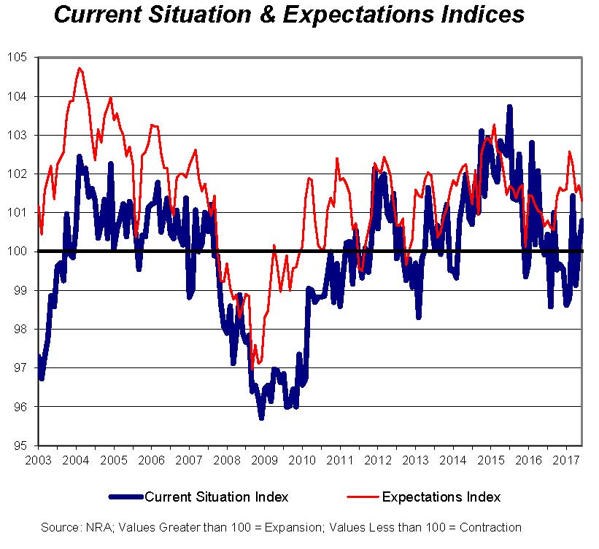
NRA Restaurant Performance Index June 2017

Slide 18
NRA Traffic Detail May 2017

Slide 19
NRA Same-Store Sales Detail May 2017

Slide 20
Eating & Drinking Place Sales, May 2016

Slide 21
NRA Same-Store Sales Outlook-May 2017

Slide 22
NRA Business Conditions Outlook-May 2017

Slide 23
Restaurants Canada Outlook Survey

Slide 24
Operator Unit Trends Recent History
Slow growth has taken its toll on the U.S. restaurant environment.
It’s a very mature, highly competitive market with thousands of operations going out of business each year.
The number of restaurant units in the U.S. has fallen from 635,494 spring 2014 to 620,807 through fall 2016, according to NPD’s ReCount census.
That’s a loss of nearly 2.4% of the total restaurants in America.
Almost all the loss has been among independents throughout the period.
According to RestaurantData.com, unit openings by independents and small chains trailed closings by nearly 3-to-1 in 2015 and 2016.
But the market remains dynamic. So-called micro-chains with 3-19 units have been growing.

Slide 25
Restaurant Unit Trends, NPD ReCount 2010-2016

Slide 26
Operator Unit Trends, NPD ReCount 2011-15
 |  |  |  |  |  |  | Fall 14 to 15
 | System Type | Fall 2011 | Fall 2012 | Fall 2013 | Fall 2014 | Fall 2015 | PCYA
TOTAL U.S. | TOTAL | 621681 | 630209 | 635996 | 633407 | 629488 | -0.6%
TOTAL U.S. | CHAIN | 274497 | 279482 | 284509 | 289726 | 292943 | 1.1%
TOTAL U.S. | INDEPENDENT | 347184 | 350727 | 351487 | 343681 | 336545 | -2.1%
Source: The NPD Group/Fall 2015 ReCount

Slide 27
Restaurant Unit Trends, NPD ReCount 2015-16
Segment | System Type | Spring 2015 | Spring 2016 | PCYA*
TOTAL RESTAURANTS | ALL | 632,572 | 624,301 | -1%
 | CHAINS | 291,794 | 292,832 | 0%
 | INDEPEN-DENTS | 340,778 | 331,469 | -3%
*Percent change from a year ago Source: The NPD Group/ReCount® Spring 2016

Slide 28
Independent & Small Chain Unit Trends RestaurantData.com

Slide 29
Fast-Growing Small Chains, 5-50 Units RestaurantData.com
Service Type | No. of Chains | Q4/2016 | Q2/2017 | % Growth
Family/Casual | 41 | 552 | 666 | 20.6%
Fast Casual | 32 | 459 | 632 | 37.7%
QSR | 18 | 224 | 278 | 24.1%
Fine Dining | 13 | 192 | 237 | 23.4%
Total | 104 | 1427 | 1813 | 27.1%

Slide 30
Operator Unit Trends, Top 500 Chains
Unit growth even among the Top 500 chains slowed in 2016. Top 500 companies added 3,847 net units in the U.S., growth of 1.7%
This compares with growth of 2% in 2014 and 1.9% in 2015
Technomic revised total number of industry-wide units up substantially. It added nearly 54,000 limited-service units and 40,000 full-service units, a total of 638,160.
This pulled Top 500 chains’ share of total units down substantially, to 56% from 65% for LSR and to 10% from 12% for full service.
Total industry unit growth for LSR was 1.4% while Top 500 LSR chains added units at a 1.9% rate.
Industrywide, full-service units rose 0.9% as Italian and seafood segments shed units.
Full-service Top 500 chains grew units at 0.5% pace in 16.

Slide 31
Operator Unit Trends, Top 500 Chains

Slide 32
Top 500 Chain Control Of Restaurant Units By Service Type, 2016

Slide 33
Top 500 Chain Share of Restaurant Market
Top 500 chain brands continue to dominate restaurant market, though dominance is heavily skewed by limited-service.
Independents dominate the full-service arena, and have increased share during the past few years. Many micro-chains in urban areas outgrowing big chains.
Even with upward unit revisions, Top 500 brands control 57% of all restaurant industry sales and 35% of units.
Top 500 chains control 82% of limited-service sales. Top 500 full-service brands control 32% of sales.
Even limited service saw some share slippage in sales 2014 to 16.
Second 250 outgrew sales of top 250 4.8% to 3.6% despite lower unit growth.
Notes:
Have only? Own less?

Slide 34
Top 500 Chains’ Market Share 2016
Notes:
Is second pie chart 2014 or 15?

Slide 35
Top 500 Chain Control Of Restaurant Sales By Service Type, 2015

Slide 36
Top 10 Chain Trends
All Top 10 in Technomic’s chain ranking posted gains save Subway, with U.S. system sales decline of 1.7% and a drop of 1.3% of its U.S. units.
Four of the Top 10 had very strong growth, while gains for the others were more moderate.
The big burger chains posted very weak growth. McDonald’s U.S. sales rose 1.5% as it shed 104 units, a 0.7% decrease.
Burger King grew sales and units 2.6% and Wendy’s sales were up only 0.6%.
Starbucks (sales up 11.3%, units 5.2%), Chick-fil-A (sales 7.2%, units 3.2%), and Dunkin’ Donuts (sales 7.9%, units 4.7%) all had good years.
Taco Bell continued to do well with sales up 6%, on a 2.6% unit increase.
Panera (sales up 5.8%, units 3.2%) lost its #10 spot to Dominos which grew sales 14.1% on a 3.3% unit increase.
Notes:
Fifth bulleted list has a comment bubble in it…dated last summer?

Slide 37
Performance of Other Leading Chains
Eleven of the Top 50 chains posted sales declines in 2016, up from six in 15.
Most striking were Chipotle’s 13.5% decline and Applebee’s drop of 6.2%.
Only six of the Top 50, including Starbucks and Domino’s, had double-digit sales gains.
Others were Panda Express (13.8%), Jimmy John’s (12.2%), Zaxby’s (15.7%) and Wingstop (18.7%). Sales gains exceeded unit increases for all four.
In addition to Zaxby’s and Chick-fil-A, other LSR chicken concepts continue fast growth including Bojangles (6.9%), Raising Cane’s (30.6%) and newcomer Slim Chickens (90.3%).
So-called “healthy” concepts such as Sweetgreen and Snap Kitchen posting very strong gains (58.5% and 55.6% respectively).

Slide 38
Top 500 Chain Segment Trends
All five major service types among Top 500 saw sales growth slow in 2016.
Fast-casual chains grew sales 8% in 16, down from 11.5% in 15, though trend is misleading given Chipotle’s problems.
Polished casual was up 4.9%, down from 5.9% in 2015.
Other full-service segments, casual dining and family dining, barely posted growth of 1.3% and 1.1% respectively.
It has been clear for years that larger full-service chains are under structural threat, especially at the lower end of the spectrum.
Remove Chipotle from the equation and fast casual continues to post strongest gains, though traditional quick service appears to be rebounding this year.

Slide 39
Top 500 Chain Segment Trends

Slide 40
Top 500 Segment Trends-Full Service
Full-service independents and small chains continue to grow sales faster than full-service Top 500 chains.
Industry full-service sales up 3.3% in 16 vs. Top 500 chains gain of only 1.4%.
Of the eight full-service menu types, independents and small chains grew faster in every segment except Asian.
The independent sales-growth rate advantage comes in spite of slightly faster unit growth by the Top 500 chains.
Small urban micro-chains are where the action is in full-service.
Sales growth of Top 500 steak concepts slowed to 2.9% in 16 from 6% in 15.
Only Asian and sports bars showed above-trend sales growth in 2016.
Technomic forecasts steak concepts and sports bars will lead growth in 2017.

Slide 41
2015 Top 500 Chain Sales & Unit Growth Trends—Full Service

Slide 42
Top 500 Segment Trends-Limited Service
In limited service, independents and small chains, though only controlling 18% of sales, grew 4.5% vs. Top 500 chains’ 4.4% growth.
(Be aware independent and small chain growth rates are even higher as numbers cite total industry growth, which includes the Top 500 chains.)
Among the 11 menu types, however, Top 500 chains outperformed independents in six of the categories.
Asian/noodle chains, led by Panda Express, grew sales 10.7%, independents 6.9%.
The coffee café segment chains, dominated by Starbucks, grew 9.7%, while total industry growth in the segment was 9.2% (Top 500 chains control 87% of market.)
Limited-service chicken, varied menu and pizza all showed strong growth.
Pizza gains driven by both big chains such as Domino’s and Papa John’s but also fast-casual concepts including Mod Pizza, Blaze Pizza and Pie Five, among others.
Notes:
Coffee Café apitalized?

Slide 43
2015 Top 500 Chain Sales & Unit Growth Trends—Limited Service

Slide 44
Beyond Restaurants Operator Trends
All the commercial market segments beyond restaurants continue to post above trend growth.
Technomic does forecast slowing growth for high-flying segments such as supermarkets, lodging and social caterers.
C-stores continue to invest in foodservice, but sales growth is just average.
Noncommercial segments show more varied growth rates.
Hospitals and senior living continue to see the strongest growth.
But schools, B&I, colleges/universities and long-term care are all experiencing below-trend growth rates.

Slide 45
Other Commercial Foodservice Segments Outlook

Slide 46
Noncommercial Foodservice Segments Outlook

Slide 47
Beyond Restaurants Operator Trends
NPD CREST Onsite has noncommercial segments (less lodging and leisure) showing 1% traffic increase for fourth consecutive year in 16.
MAFSI Barometer still tracking strong consultant and RFP activity in noncommercial segments.
Both state and local tax receipt growth is slowing.
State receipts went negative in the fourth quarter of 2016 and while trend appeared to improve 1Q/17, income tax receipts fell in April this year.
Rockefeller Institute blames “Trump Effect,” as promises of tax cuts led taxpayers to hold off declaring capital gains.
But the Institute also worries economy is weaker than it appears.

Slide 48
Noncommercial Traffic Rises Again; QSR Goes Flat
Total Foodservice
Traffic +1%
Traffic % Change vs. Year Ago
QSR* 69%
Midscale* 8%
Casual Dining * 9%
Total
Non-Commercial 13%
(Share of Total Foodservice); *Excludes Amusement, Lodging, Casino Source: The NPD Group/CREST OnSite®

Slide 49
State & Local Tax Trends, Four-Quarter Moving Average

Slide 50
State Tax Trends 1Q/2017 and April 2017

Slide 51
Operator Cost & Profit Trends—Food
Operator margins benefited greatly from nearly two years of food price declines, with prices down as much as 5%.
But since November last year, the party is over.
Average wholesale food prices have risen every month since and were up 4% through May and up again in June.
While USDA still expects falling prices for most proteins, increases for beef, and fresh fruits and vegetables have been higher than forecast.
This is putting even more pressure on operator margins.
Operators had continued to raise menu prices in the 2.2% to 2.5% range throughout the period of food price declines, mostly to cover labor costs
Only good thing of rising wholesales food price is grocery stores have raised prices, narrowing price trend gap with foodservice.

Slide 52
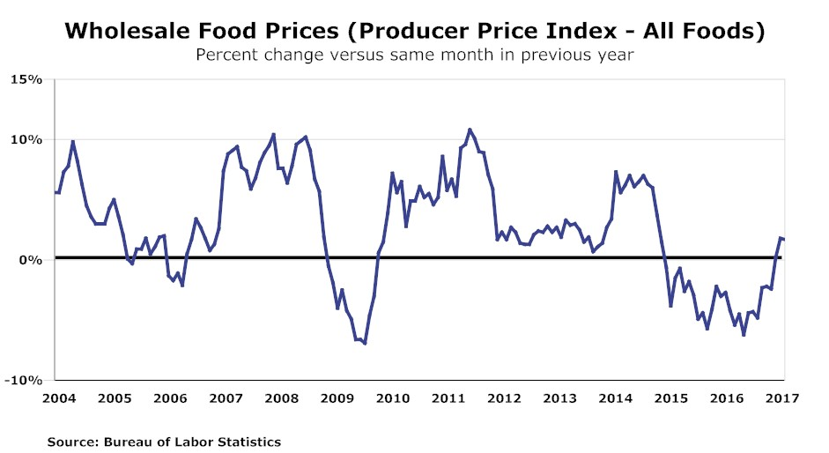
Wholesale Food Prices, 2004- May 2017

Slide 53
Wholesale Food Price Trends & Forecast

Slide 54
Menu & Grocery Price Trends 2004-May 2017

Slide 55
Operator Cost Trends—Labor
The pressure on operator labor costs remains intense.
Minimum-wage hikes continue throughout the country, even in places one wouldn’t expect such as North Dakota and Arkansas.
But such “living wage” increases are only part of the problem.
With the economy near full employment and restaurants adding employees at a robust pace, operators are competing for workers.
And the Trump Administration’s crackdown on immigration has shrunk the pool of available workers, especially back of the house.
The administration has put on hold an Obama-era rule raising the salary limits on “managers” excluded from overtime pay to $47,476 a year, as well as an NLRB push to hold franchisors “jointly responsible” for franchisees’ labor practices.

Slide 56
Average Hourly Foodservice Wage Trends

Slide 57
International Economic & Operator Trends

Slide 58
International Forecasts
Major economies around the world are performing marginally better in 2017.
All the major European economies are seeing slightly stronger GDP growth.
Exception is Britain where continuing Brexit anxieties are slowing growth.
Russia and Brazil are finally coming out of recession and growth is forecast to improve again in 2018.
India continues to boom while China’s growth gradually slows. Most other major Asian economies are posting moderately better growth, including Japan.
And GDP growth is improving in Canada and the U.S. after sluggish 2016s though slowing slightly in Mexico.

Slide 59
Real GDP Growth & Blue Chip Forecasts

Slide 60
Real GDP Growth & Blue Chip Forecasts

Slide 61
Real GDP Growth & Blue Chip Forecasts

Slide 62
Real GDP Growth & Blue Chip Forecasts

Slide 63
Global Foodservice Trends
The improved economic situation in many countries is translating into positive foodservice traffic and sales trends.
Nine of the 12 markets followed by the NPD Group saw traffic gains 1Q/17.
All five European markets, including, the U.K., saw increased visits.
China and Canada saw traffic increase by 2% or more.
Only Brazil and Russia had declining traffic as both emerge from recession.
With the U.S. and Canadian market so mature, major U.S. chains continue to target unit growth everywhere but.
There has been a surge by fast-casual brands, especially hamburger concepts, moving offshore.

Slide 64
Internationally Active U.S. Chains

Slide 65
Components of Spending
Components of Spending
% Change vs. Year Ago
Q1 2017
Spend
Avg Eater Check*
(*In US Dollars – converted 8/16/16)
* Russia represents 8 cities
~ Brazil represents 15-59, class A-C
^ China represents 22 cities
Source: The NPD Group/CREST©

Slide 66
Credits And Acknowledgments
We are highly dependent on Technomic Inc. for insight and operator forecasts and data, including data from their annual Top 500 Restaurant Chains Report. Special thanks to Joe Pawlak and David Henkes.
Information on Technomic research products available at www.technomic.com.
We thank the National Restaurant Association for sharing their forecasts and information from the Restaurant Performance Index and Restaurant Trendmapper. Info available at www.restaurant.org.
We thank NPD Group for material on traffic and other trends. Special thanks to Kim McLynn for all her help. Info at www.npd.com.
We thank Joe Dunbar and Keith Gellman from RestaurantData.com for data on unit openings and closings and growing small chains. Info at www.restaurantdata.com.
We thank Restaurants Canada for data and forecasts on the Canadian foodservice market. More information at www.restaurantscanada.org.
The chart on slide 7 is borrowed from MAFSI’s 2017 E&S Market Forecast report.
Information on state and local tax trends comes from the Nelson A. Rockefeller Institute of Government. Info at www.rockinst.org.

