Slide 1
FER Top 100 U.S.
Equipment & Supplies
Manufacturers 2017

Slide 2
FER’s Top 100 E&S Manufacturers Overview
This is now the ninth year FER has listed and ranked the 100 largest manufacturers of foodservice equipment, durable supplies, furnishings and components.
Methodology remains consistent with past listings. The ranking is based on 2016 sales. For public companies on which we have data, we convert to calendar fiscal.
We revise numbers when we get better info. We also revise past years to maintain consistent year-to-year tracking.
Numbers include exports to make consistent with NAFEM Size & Shape. Size & Shape does not include parts, but we can’t say these numbers do not.
For the most part, numbers for companies based in the U.S. are global, numbers for companies based elsewhere are for American divisions only. Exception: ITW FEG.
We do this, again, to try to align with Size & Shape.

Slide 3
FER Top 100 E&S Manufacturers Overview
Growth of FER’s Top 100 E&S Manufacturers rebounded in 2016.
The Top 100 grew combined revenues 5.7% last year, compared with weak 3.5% growth in 2015.
As a group, the Top 100 returned to their traditional pace of growing faster than our estimate of 4.3% total industry nominal growth last year and the 4.4% average quarterly growth for the MAFSI Barometer in 16.
Revised Top 100 total for 16 was $14.709 billion compared to $13.910 billion in 15 and $13.455 billion in 14.
By revised, we mean we use volumes for 2016’s Top 100 in earlier years.
Remember, there is a lot of double counting and revenues not captured by NAFEM Size & Shape in these numbers.

Slide 4
FER Top 100 Mfrs., Change vs. Prior Year

Slide 5
FER Top 100 E&S Manufacturers Overview
What was behind the rebound were the same factors that caused the slowdown in growth last year: Sales for the big chain-oriented companies improved.
Only three of the Top 25 saw sales decline last year, compared to eight in 2015, and in two cases, Welbilt and Standex, divestitures played a role in the drops.
The Top 10 and Top 25 Manufacturers outpaced the average growth of the Top 100 with revenue growth of 7.2% and 6.5% respectively.
Last year, the Top 10 companies managed growth of only the 3.5%, the Top 25 3.2%.
The gains at the largest companies came in spite of continued softness among the eight publicly reporting companies. They grew combined sales only 2.2% in 16.
Part of the gains can be attributed to the acquisition by Ali Group North America of Metro, Marmon Foodservice’s purchase of Angelo Po, and Middleby Corp.’s acquisition of Follett.

Slide 6
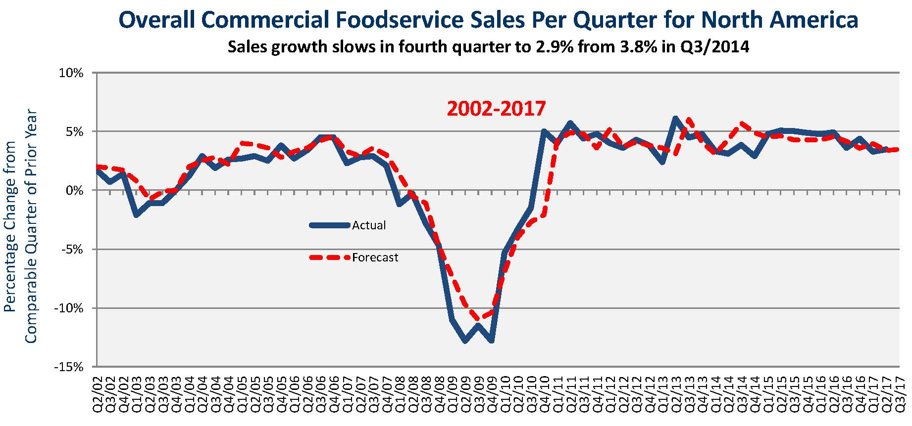
MAFSI Barometer History-2Q/2017 Prelim.

Slide 7
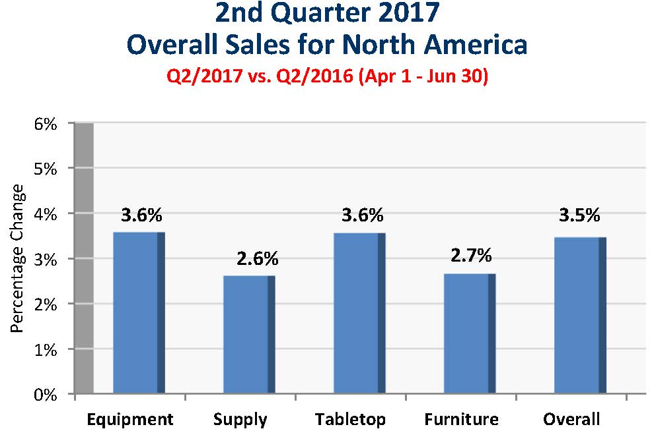
MAFSI Barometer—2Q/17 Prelim.

Slide 8
Public E&S Company Blended Sales,
Quarterly % Changes Vs. Year Prior Thru 1Q/17

Slide 9
Public E&S Company Blended Sales,
Quarterly % Changes Vs. Year Prior, 1Q/17

Slide 10
FER Top 100 E&S Manufacturers: 1-25
 |  |  | Estimated | Estimated | Estimated
 |  | 16 vs.15 | ($MM) | ($MM) | ($MM)
 | Company | % Change | 2016 | 2015 | 2014
1 | Manitowoc FS | -7.2% | 1456.6 | 1570.1 | 1581.3
2 | Middleby | 13.0% | 1267.0 | 1121.1 | 1041.2
3 | Ali Group FS NA | 33.7% | 960.0 | 718.0 | 703.0
4 | ITW Foodservice NA | 6.6% | 815.5 | 765.0 | 725.2
5 | Marmon Foodservice | 18.9% | 725.0 | 610.0 | 602.0
6 | Hoshizaki Holdings | 6.0% | 530.0 | 500.0 | 470.0
7 | Libbey FS | 2.3% | 480.6 | 469.8 | 443.9
8 | Vollrath | 5.4% | 417.1 | 395.7 | 366.0
9 | Captive Aire | 8.0% | 378.0 | 350.0 | 339.0
10 | Standex Foodservice | -7.7% | 368.6 | 399.4 | 407.5
11 | Cambro | 0.3% | 349.0 | 348.0 | 304.5
12 | True Foodservice | 3.1% | 330.0 | 320.0 | 331.0
13 | Carrier Foodservice | 6.0% | 305.8 | 288.5 | 291.0
14 | Bunn O Matic | 5.2% | 255.3 | 242.6 | 233.3
15 | Carlisle FS | 3.1% | 250.2 | 242.6 | 244.2
16 | Henny Penny | 7.1% | 225.0 | 210.0 | 210.0
17 | Dover Unified Brands | 2.2% | 205.7 | 201.3 | 196.9
18 | Franke Contract Group | 10.3% | 201.0 | 182.3 | 184.0
19 | Pentair / Everpure FS | 4.9% | 194.0 | 185.0 | 175.0
20 | Rubbermaid FS | 0.5% | 185.0 | 184.0 | 190.5
21 | Hatco | 7.8% | 169.5 | 157.2 | 145.3
22 | Alto Shaam | 8.2% | 159.7 | 147.6 | 134.4
23 | Duke Mfg | -3.1% | 155.0 | 160.0 | 150.0
24 | H&K International | 23.9% | 154.0 | 124.3 | 131.4
25 | Rational Americas | 27.0% | 151.1 | 119.0 | 105.9
 | Top 25 | 6.5% | 10537.6 | 9892.5 | 9600.6

Slide 11
FER Top 100 E&S Manufacturers: 26-50
 |  |  | Estimated | Estimated | Estimated
 |  | 16 vs.15 | ($MM) | ($MM) | ($MM)
 | Company | % Change | 2016 | 2015 | 2014
26 | Halton | 3.7% | 119.3 | 115.0 | 112
27 | Rational Americas | 12.4% | 119.0 | 105.9 | 109.4
28 | Winco/DWL Industries | 6.5% | 106.3 | 99.8 | 89.6
29 | Turbo Air | 7.9% | 104.0 | 96.4 | 91.8
30 | Steelite International | 8.6% | 101.2 | 93.2 | 88.4
31 | N. Wasserstrom | 4.6% | 95.1 | 90.9 | 87
32 | EveryWare/Oneida | -15.7% | 92.4 | 109.6 | 126.5
33 | Crown Brands | 4.5% | 90.2 | 86.3 | 77
34 | San Jamar | -6.3% | 86.2 | 92.0 | 91.2
35 | Advance Tabco | 6.8% | 85.3 | 79.9 | 73
36 | Perlick | 5.9% | 83.2 | 78.6 | 74
37 | Server Products | 8.5% | 82.1 | 75.7 | 70.6
38 | AJ Antunes | 4.1% | 74.3 | 71.4 | 68
39 | Continental/Bally | 4.8% | 73.8 | 70.4 | 66
40 | Cecilware/Grindmaster | 5.0% | 73.5 | 70.0 | 69.5
41 | Dwyer Instruments | 1.9% | 73.4 | 72.0 | 70
42 | Therm Kool/Mid-south | 7.4% | 71.1 | 66.2 | 62.3
43 | G.E.T. | 8.9% | 70.1 | 64.4 | 60.2
44 | Vita Mix | 5.1% | 67.5 | 64.2 | 60
45 | Eagle Metal Masters | 6.9% | 66.9 | 62.6 | 58.7
46 | Loren Cook Co. | -3.7% | 65.4 | 67.9 | 66
47 | Follet Ice | 6.5% | 64.2 | 60.3 | 56.8
48 | Wells Lamont Industry | 1.9% | 63.2 | 62.0 | 60.4
49 | Ansul Inc | 2.3% | 61.3 | 59.9 | 58
50 | MicroMatic | 5.7% | 60.8 | 57.5 | 53.4
 | Second 25 | 4.4% | 2262.1 | 2166.4 | 2085.8

Slide 12
FER Top 100 E&S Manufacturers: 51-75
 |  |  | Estimated | Estimated | Estimated
 |  | 16 vs.15 | ($MM) | ($MM) | ($MM)
 | Company | % Change | 2016 | 2015 | 2014
51 | Electrolux NA | 4.3% | 60.9 | 58.4 | 56.9
52 | Greenheck/Accurex | 4.2% | 59.5 | 57.1 | 55.2
53 | Lakeside Mfg/Sandstone | 3.2% | 58.9 | 57.1 | 54.6
54 | Cardinal/Detecto Scale | 4.9% | 57.5 | 54.8 | 52.4
55 | Kidde Fire Systems | 0.5% | 55.0 | 54.7 | 53.6
56 | Thunder Group | 0.9% | 54.3 | 53.8 | 51.5
57 | Zurn Industries | -1.5% | 54.0 | 54.8 | 53.1
58 | Wilbur Curtis | 6.6% | 53.4 | 50.1 | 47.5
59 | Hamilton Beach | 1.8% | 52.3 | 51.4 | 48.6
60 | Gold Medal | 2.6% | 51.6 | 50.3 | 48.1
61 | Plymold/Foldcraft | 2.0% | 50.9 | 49.9 | 47.8
62 | WinHolt | 3.1% | 49.8 | 48.3 | 45.9
63 | Front of the House/FOH | 2.1% | 48.6 | 47.6 | 45.2
64 | Nemco | 5.5% | 47.9 | 45.4 | 42.2
65 | In-Sink-Erator | 4.8% | 47.8 | 45.6 | 43.8
66 | Homer Laughlin China | 3.2% | 45.8 | 44.4 | 42.3
67 | Fortessa | 3.4% | 45.8 | 44.3 | 42.3
68 | Globe | 6.1% | 45.2 | 42.6 | 39.5
69 | Imperial Mfg. | 1.8% | 45.1 | 44.3 | 42.3
70 | SPG | -4.9% | 44.8 | 47.1 | 45.9
71 | RH Forschner/Swiss Army | 1.6% | 43.6 | 42.9 | 41.1
72 | Robot Coupe | 4.6% | 43.1 | 41.2 | 38.5
73 | Johnson/Diversay/Auto chlor | 2.5% | 41.3 | 40.3 | 38.7
74 | American Metalcraft | 3.0% | 41.2 | 40.0 | 38.1
75 | Cooper Atkins | 4.9% | 40.8 | 38.9 | 36.9
 | Third 25 | 2.7% | 1257.8 | 1225.3 | 1169.6

Slide 13
FER Top 100 E&S Manufacturers: 76-100
 |  |  | Estimated | Estimated | Estimated
 |  | 16 vs.15 | ($MM) | ($MM) | ($MM)
 | Company | % Change | 2016 | 2015 | 2014
76 | Tablecraft | 2.3% | 39.9 | 39.0 | 37.3
77 | Giles | 0.8% | 39.7 | 39.4 | 37.2
78 | CresCor | 6.6% | 38.9 | 36.5 | 34.8
79 | Oliver Products | 1.3% | 38.1 | 37.6 | 35.9
80 | Food Warming Equip | 5.5% | 38.1 | 36.1 | 34.3
81 | Mahoney Environmental Inc. | 4.5% | 36.9 | 35.3 | 34.1
82 | Selkirk llc | -0.6% | 33.8 | 34.0 | 33.2
83 | Walco Stainless | 2.3% | 30.9 | 30.2 | 28.8
84 | Glasstender | 4.9% | 30.1 | 28.7 | 27.4
85 | American Panel | 5.7% | 29.8 | 28.2 | 26.9
86 | Metal-Fab Inc. | 3.5% | 29.4 | 28.4 | 27.8
87 | Waring Commercial | 5.6% | 28.4 | 26.9 | 25.6
88 | T&S Brass & Bronze | 6.8% | 28.4 | 26.6 | 25.2
89 | Service Ideas | 2.2% | 28.1 | 27.5 | 26.1
90 | Accutemp | 4.9% | 28.0 | 26.7 | 25.4
91 | Blendtec | 5.7% | 27.6 | 26.1 | 24.8
92 | LowTemp Industries | 5.2% | 26.4 | 25.1 | 24.0
93 | John Boos | 4.8% | 26.1 | 24.9 | 23.9
94 | New Age | 4.9% | 25.9 | 24.7 | 23.5
95 | FETCO | 5.3% | 25.8 | 24.5 | 23.4
96 | Winston Ind. | 2.8% | 25.7 | 25.0 | 24.3
97 | Montague | 4.5% | 25.4 | 24.3 | 23.2
98 | Atlas Metal | 5.0% | 25.4 | 24.2 | 23.1
99 | Allegacy | 2.1% | 24.7 | 24.2 | 23.2
100 | CandleLamp/Sterno | 3.0% | 24.1 | 23.4 | 22.1
 | Fourth 25 | 4.2% | 651.9 | 625.7 | 598.9
 | Top 100 Manufacturers | 5.7% | 14709.4 | 13909.9 | 13454.9

Slide 14
FER Top 100 E&S Manufacturers Overview
Growth of the Top 10 and top quartile showed substantial improvement in 2016 compared to growth in 2015.
Top 25 were up 6.5% vs. growth of just 3.2% in 2015 and the Top 10 saw gains of 7.2% vs. 3.5% in 15, thanks in part to acquisitions.
But Top 25 control of Top 100 sales declined again slightly, from 71.8% in 15 to 71.6% in 16. The controlled 73% in 14.
The second quartile grew slightly faster than in 2015. But the third and fourth quartiles saw growth rate fall slightly.
With growth of only 2.7%, third quartile was off industry growth of 4.3%, per FER estimates, by a wide margin.

Slide 15
FER Top 100 E&S Manufacturers
Performance By Quartile
 | 15 vs. 14 | ($MM) | % of 100
Top 100 Mfrs | 3.5% | 14222.8 | 1
Top 10 | 3.5% | 7075.9 | 49.8%
Top 25 | 3.2% | 10205.3 | 71.8%
Second 25 | 4.0% | 2166.5 | 15.2%
Third 25 | 4.8% | 1225.3 | 8.6%
Fourth 25 | 4.5% | 625.7 | 4.4%

Slide 16
FER Top 100 E&S Manufacturers
Performance By Quartile
 | 15 vs. 14 | ($MM) | % of 100
Top 100 Mfrs | 5.7% | 14709.4 | 1
Top 10 | 7.2% | 7398.4 | 50.2%
Top 25 | 6.5% | 10537.6 | 71.6%
Second 25 | 4.4% | 2262.1 | 15.4%
Third 25 | 2.7% | 1257.8 | 8.6%
Fourth 25 | 4.2% | 651.9 | 4.4%

Slide 17
The Global Players
We want the FER Top 100 Manufacturers list to reflect NAFEM “Size & Shape” numbers as closely as possible.
Thus, we do not count global E&S sales of companies based outside of North America, just sales within North America.
We also are not consistent. We don’t count ITW FEG outside N.A., for example.
And in this ranking we count service and retail for ITW, laundry for Electrolux Professional. But don’t count retail and industrial for Middleby.
This creates a bit of an apples-to-oranges scenario.
What follows are our best research and estimates of the 2016 global sales of the leading global E&S companies. Most grew in 2016.

Slide 18
The Global Players
Company Global Sales 2016 ($US MM)
Ali Group $2,370
Hoshizaki $2,275
ITW FEG $2,110
Manitowoc Foodservice $1,457
Middleby $1,157
Marmon Foodservice $725
Electrolux Professional $892
Rational $626
Libbey Foodservice $481
Standex Foodservice $367

Slide 19
Merger & Acquisition Activity
Mergers & acquisition activity among manufacturers has slowed a bit since 2015 and the first half of 2016.
But things appear to be picking up in the first half of 2017.
Electrolux made its first acquisition in the U.S. in years, picking up beverage equipment maker Grindmaster Cecilware.
Shore-View Industries, a P.E. company, bought Spring USA from Fiskars last year, created Cornerstone Foodservice Group, then bought Lloyd Pans in July.
Middleby bought an industrial bakery equipment company Burford, but has been quiet on the foodservice side.
The other big conglomerates have been quiet this year.
Vollrath picked up Belleco, adding to its countertop cooking equipment lines.

Slide 20
Merger & Acquisition Activity
2014 Deals: Middleby bought Market Forge, ABC/Wunderbar, Concordia Coffee, U-Line Corp., Desmon, and Goldstein-Eswood; Standex bought Ultrafryer Systems and sold American Foodservice to All American Holdings; Argosy Group Int’l. acquired Donper America; Duke Mfg. bought CounterCraft; Polyscience Culinary sold distribution rights to Breville Group; Advance Tabco acquired Supreme Metal; Compass Diversified Holdings bought Candle Lamp (SternoCandleLamp); Focus Foodservice parent Centre Lane Partners bought Update Int’l. and Johnson-Rose; Taylor Precision Products bought Chef’n Corp.; Henny Penny and Wood Stone sold to ESOP.

Slide 21
Merger & Acquisition Activity
2015 Deals: Middleby bought Induc Comm. Electric, Marsal & Sons, AGA Rangemaster, and Lynx; Halton Group bought Air Scrubbers; G.E.T. merged with Bugambilia Int’l. and Culinaire by Mikon Int’l.; Franke Foodservice bought Easi-Serv Products; Electrolux acquired Veetsan Comm. Machinery; Automated Equipment acquired Aerotech; Standex sold Bevles to Legacy Cos.; Ecolab bought U.S. operations of Swisher Hygiene; Vollrath bought Miguel Pujadas; Micromatic bought Valpar; Ali Group bought Intermetro from Emerson; Crown Brands bought Co-Rect Products; Restaurant Technologies bought PureFill Solutions; Aquion acquired Procam Controls; KPS Global bought Kysor Panel from Manitowoc; Hoshizaki/Lancer and Blendtec signed deal under which Lancer and Blendtec combined manufacturing, marketing and service.

Slide 22
Merger & Acquisition Activity
2016 Deals: Candlelamp/Sterno bought Northern Int’l.; Nemco acquired rights to make and distribute Dipo Induction equipment; Middleby bought Follett; Marmon Foodservice bought Italy’s Angelo Po, and later, Dominioni Punto & Pasta ; the Legacy Cos. bought Chef’s Choice and Legion Industries; Component Hardware bought Specialty Foodservice Hardware and then Food Service Parts from John S. Dull; Denmark’s Fiskars sold Spring USA to Shore-View Industries, which formed Cornerstone Foodservice Group.
2017 Deals So Far: Imperial Brown acquired Artic Temp; Electrolux Professional bought Grindmaster Cecilware; Franke Foodservice bought fabricator Sertek; DeLonghi bought 40% of Swiss commercial coffee machine maker Eversys; Vollrath bought Belleco; Middleby purchased industrial baking equipment maker Burford; Cornerstone Foodservice Group bought Lloyd Pans; Montague bought TurboCoil.

